Slide 1

DriverPass System Analysis
Mohamed Elhassan
Notes:
[No speaker notes required for this slide.]

Slide 2

System Requirements
Functional Requirements:
Online Practice Exams: The system will provide online practice exams to help students prepare for driving tests.
Scheduling System: The system shall allow users to schedule driving lessons with available instructors and vehicles, accommodating user preferences for date and time.
Nonfunctional Requirements:
Accessibility: The system will be accessible via web browsers and mobile devices to ensure widespread availability.
Scalability: The system must efficiently handle increases in user traffic and data volume without performance degradation
Notes:
Today, we'll explore some key capabilities of our DriverPass system. First, let's talk about functional requirements: Our system enables students to access online practice exams and schedule driving lessons at their convenience. These features are designed to enhance the learning experience and provide flexibility in preparing for driving tests. On the nonfunctional side, our system is accessible from any device—be it a smartphone, tablet, or computer—ensuring that all students can study or book lessons no matter where they are. Additionally, we've designed DriverPass to handle more users and data as our service grows without slowing down or compromising on performance, making it a scalable solution for the future.

Slide 3
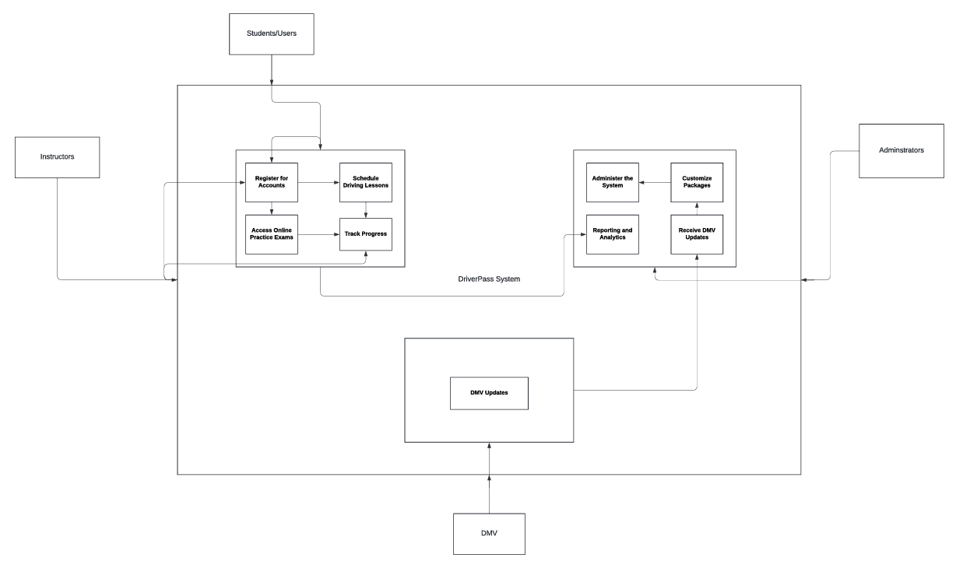
Use Case Diagram
Notes:
This visual, while simple, represents the heart of how our users interact with DriverPass. Students can register, access materials, and book lessons, while instructors manage their schedules and sessions. The system supports administrators in overseeing these processes and also allows for updates directly from the DMV. We designed these interactions to be as user-friendly as possible, ensuring that every step from signing up to scheduling is straightforward and clear. This ensures that both tech-savvy and less technical users can navigate our system with ease, making the process of learning to drive as seamless as possible.

Slide 4
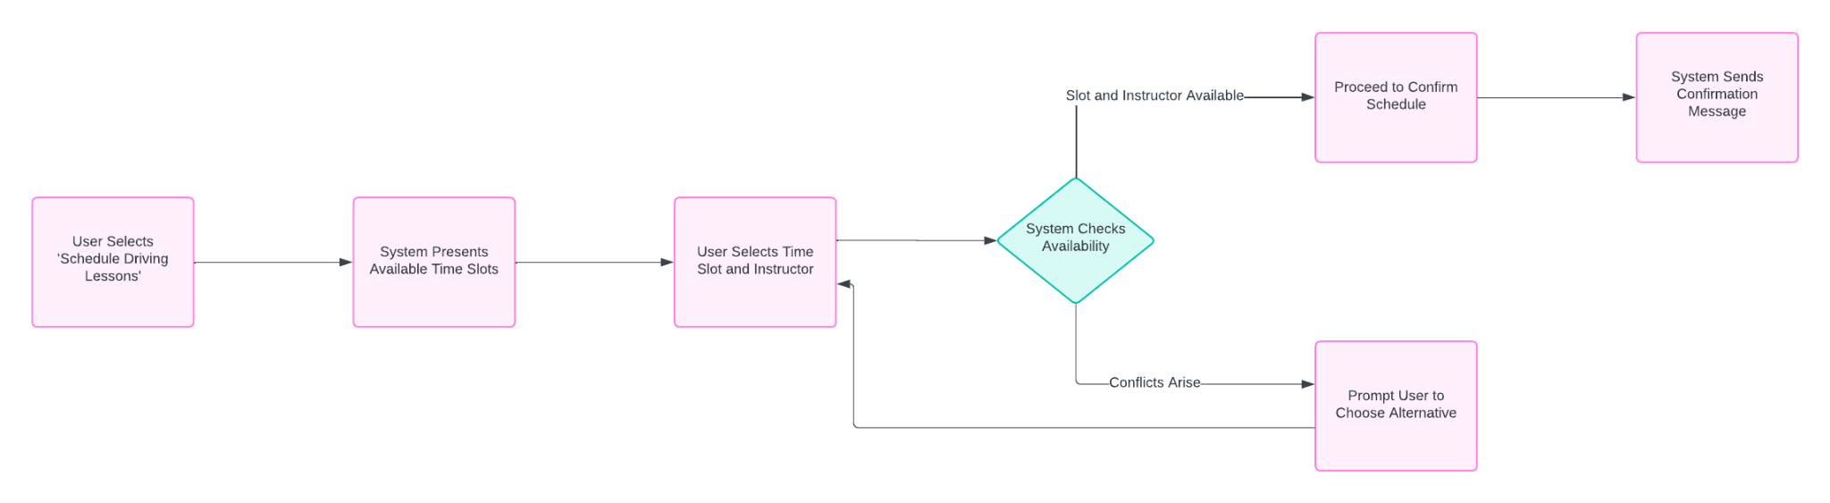
Activity Diagram
Notes:
Let’s dive into one specific feature—scheduling driving lessons. Our activity diagram here outlines the steps involved. A student logs in, selects a preferred date and time for a lesson, and confirms the booking. If there is a conflict in the scheduling times, a failure message will show and the student will be prompted back to the selection screen. We've streamlined these steps to remove any unnecessary complexity, ensuring that even users new to our platform can schedule their driving lessons without hassle.

Slide 5
Security
Multi-Factor Authentication: Secure user login with multi-factor authentication.
Data Encryption: All data exchanges are encrypted to ensure user information is protected against unauthorized access.
Brute Force Protection: Account lockout mechanisms to prevent brute force attacks.
Notes:
Security is a top priority in the design of the DriverPass system. We use multi-factor authentication, which means users need more than just a password to access their accounts—adding an extra layer of security. All data sent to and from our system is encrypted, protecting it from unauthorized access. Furthermore, in response to multiple failed login attempts, our system will automatically lock the account to prevent potential security breaches. These measures ensure that our users' data is safe and secure, providing peace of mind for both students and instructors.

Slide 6
System Limitations
Internet Dependency: The system requires an active internet connection to access all features.
Resource Intensive: Best performance on modern hardware, which may not be available to all users.
Maintenance Downtimes: Scheduled maintenance may temporarily affect access to the system.
Notes:
While DriverPass offers great tools to aid in driver education, there are a few limitations we're continuously working to improve. The system requires an internet connection to access all features, which might be a limitation in areas with poor connectivity. Additionally, while our system is optimized for modern hardware, users with older devices might experience slower performance. Scheduled maintenance is necessary for keeping the system up-to-date and running smoothly, though it may temporarily limit access to certain features. We are actively working on solutions to these challenges to make our services more accessible.

